Slide 1

#PokemonGO: Gotta Catch ’em All (Data)
Group 3
Deepan, Dhaval, Karan, Rohitpal, Bhakti

Slide 2
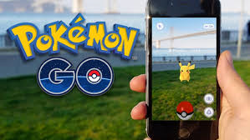
Our Topic : Pokémon Go
What is Pokémon Go?
Based on the popular Japanese cartoon TV series Pokémon
The game is based on augmented reality, using the devices having Android and iOS systems installed
Released in selected parts of the world on July 6th, 2016
Free download from Google Playstore or Apple’s Appstore
Location-based game, uses mobile devices GPS capabilities
Supports in-app purchases for additional items
Basically locates, catches and fights Pokémon(Virtual Characters)

Slide 3
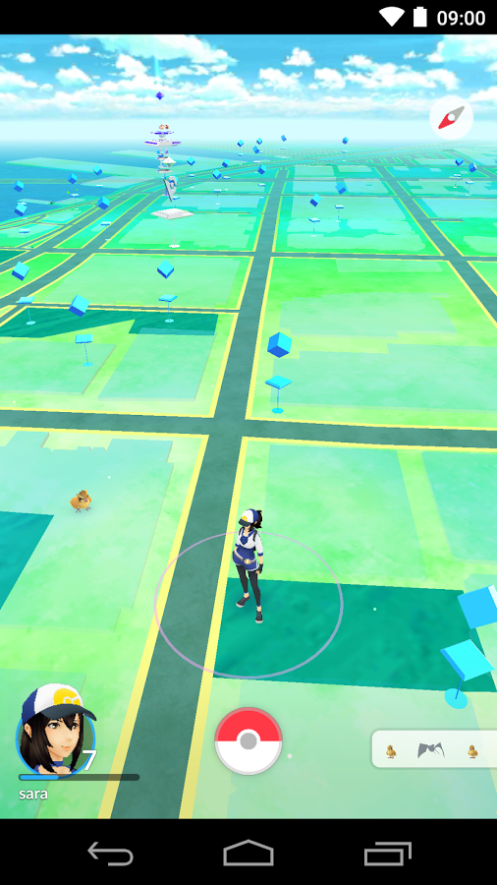
Why Pokémon Go?
All the team members are active game players or more better, Pokémon Trainers
Game became an instant hit, it was a global phenomenon
One of the most used and profitable mobile apps in 2016
Generated a lot of public interest, hence our interest as well
Downloaded more than 500 million times worldwide
Fastest time to gross $100 million by a mobile game, within 20 days
Because of the popularity, Pokémon Go is influencing many business areas such as restaurants, retail merchandising etc.
Game was harshly criticized for problems related to road accidents, lag in application, server breakdown etc.
We were interested in knowing what were the trends for Pokémon go on twitter

Slide 4

Data Collection
Twitter streaming API
We used the hashtag #PokemonGO, #playing, #PokemonServers,#DontCatchandDrive and keywords Pokémon hate, Pokémon love, Pokémon Restaurant, Pokemon Burger, Pokemon Pizza, Pokémon accidents for extracting the recent tweets
Based on twitter accounts, location, time zone, retweets and followers
Follower count : 1,20,000 and counting
Count of tweets collected: 12,029
Size of tweets: 33.5MB
NLTK and Regex were used for data processing

Slide 5
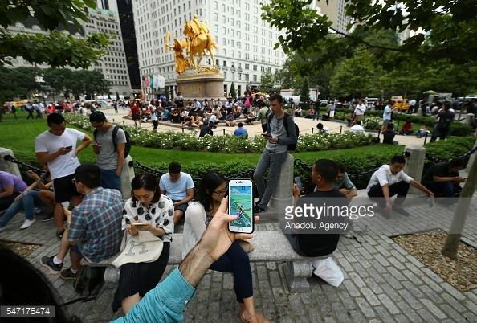
Targeted Business Problems
Server enhancements
Road accidents, mishaps
Love vs Hate
Target Markets

Slide 6
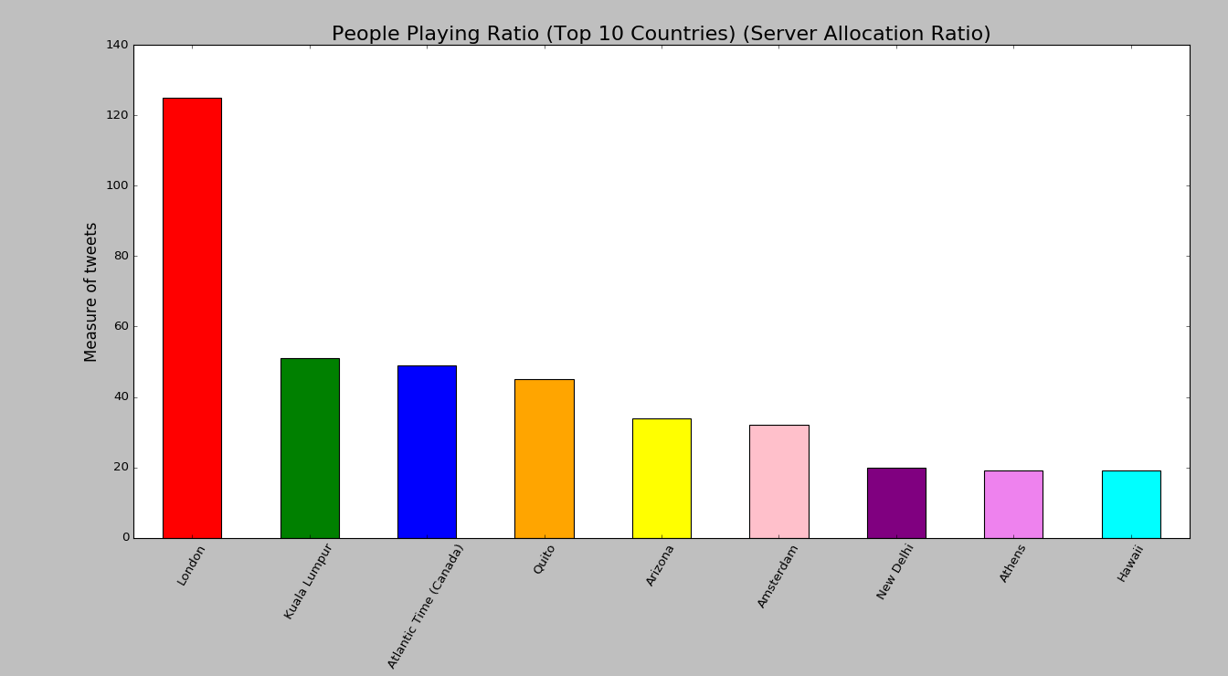
Server Enhancements
Used stream API to extract data based on #PokemonGo
Segregated tweets by filtering on time zone and keywords #pokemongo, #playing
Recommendations to install more servers and enhancements

Slide 7
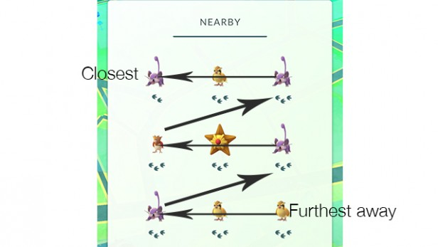
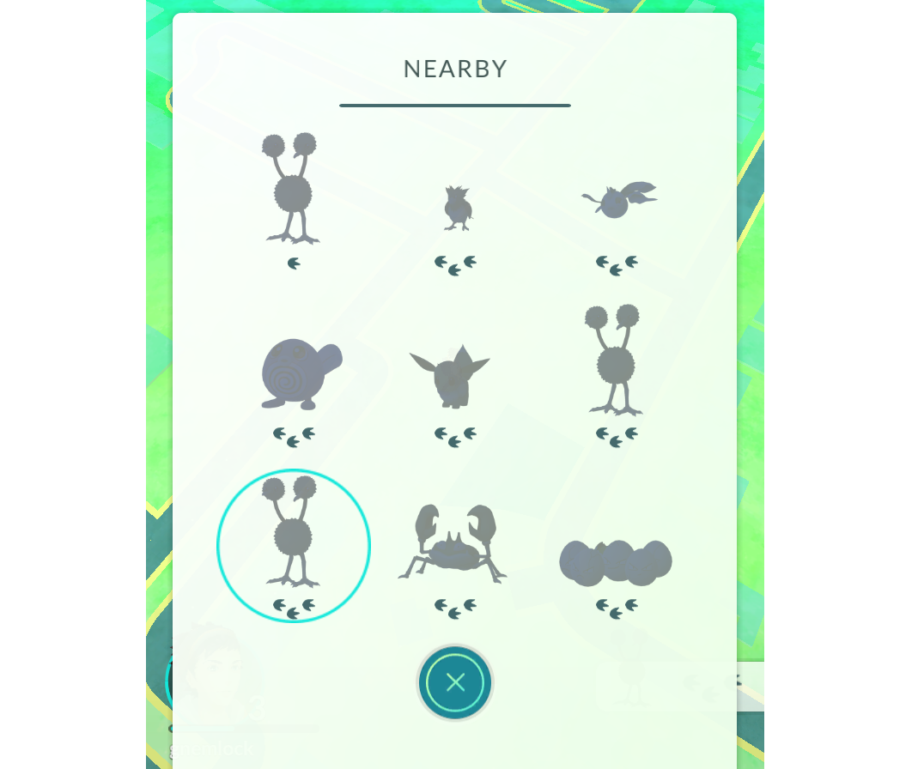
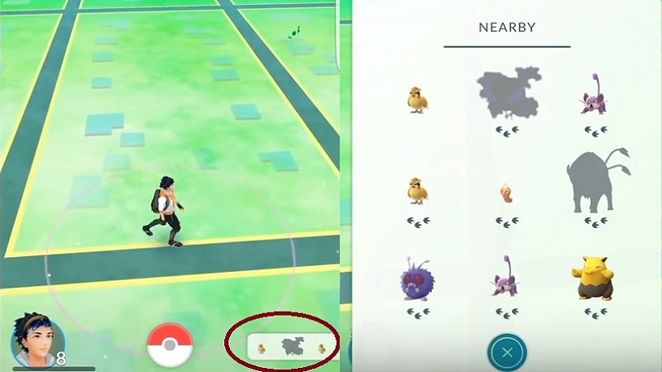
Road Accidents
Nearby Feature
Increases curiosity of players

Slide 8
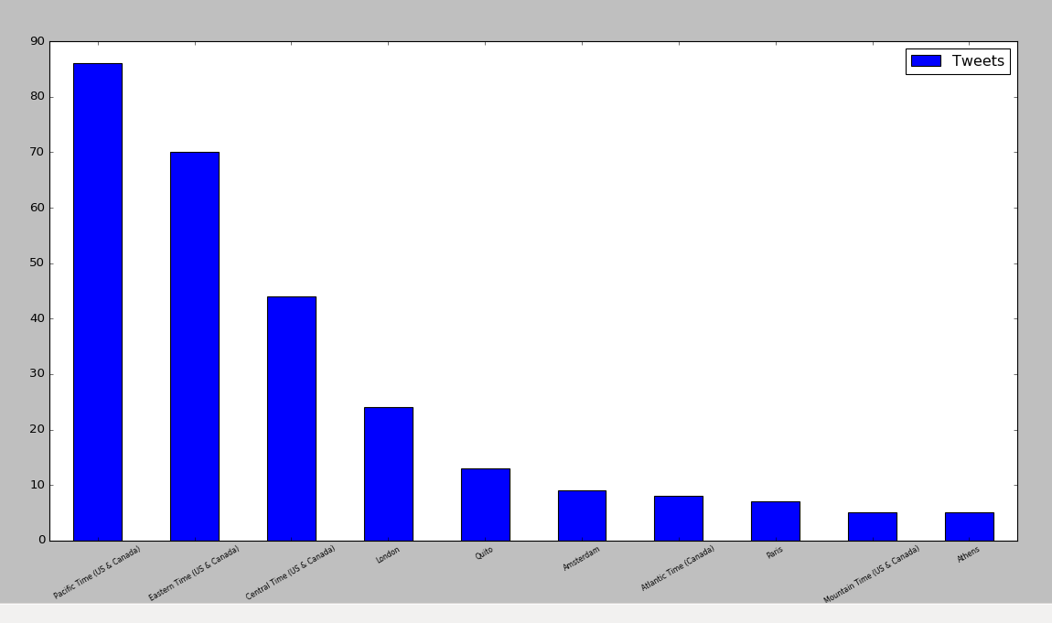
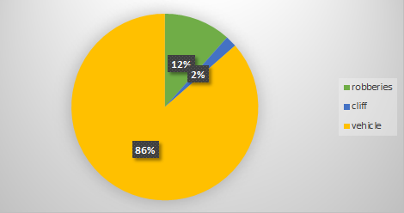
Road Accidents
Vehicle Accidents
Cliff Fall
Robbery
Accidents based on time zone (Location)

Slide 9
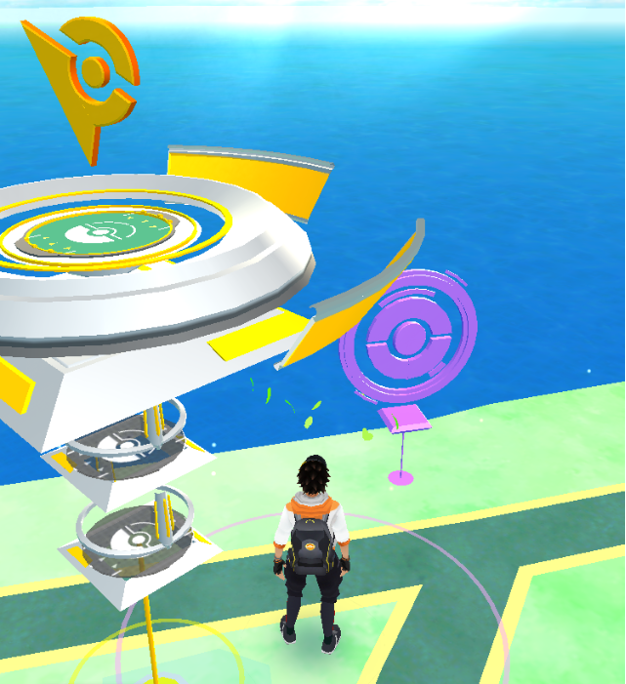
Recommendations
Access the geospatial data and know the accident prone areas
Reduce the number of Pokémon sightings in that area
Reduce the number of Poke Stops and Poke Gyms

Slide 10
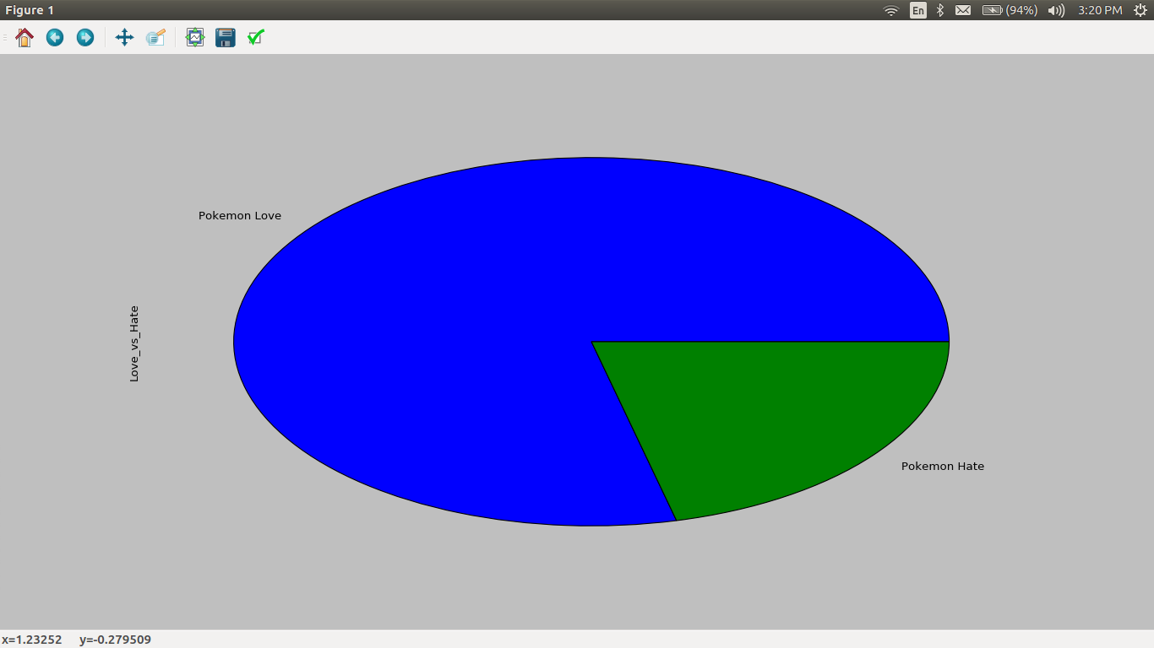
Love VS Hate
Sentimental analysis
Extracted tweets with keywords Pokémon hate and Pokémon Love
Love: 77%
Hate: 23%
Love VS Hate #PokemonGo

Slide 11
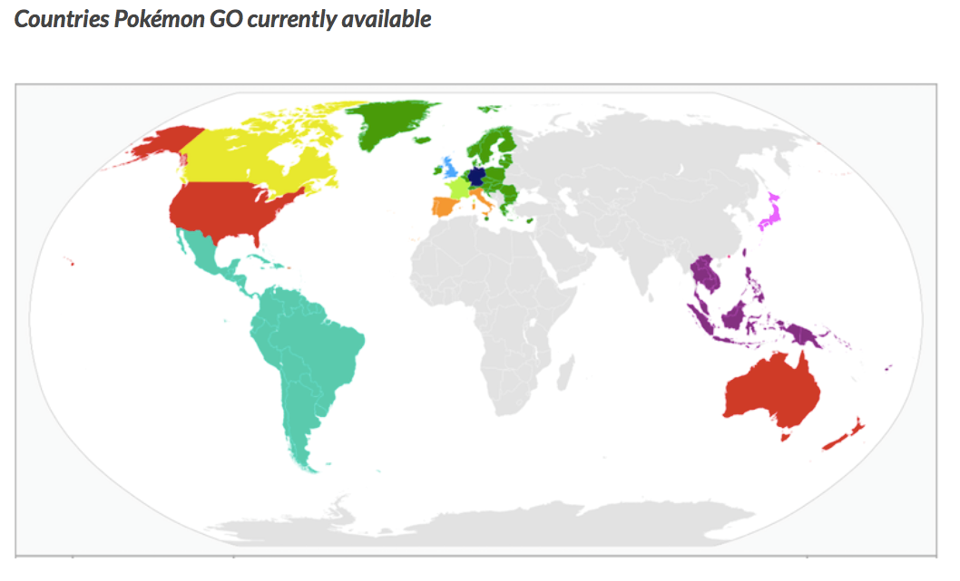
Target Markets
Official availability of Pokémon GO App
USA, UK, Australia etc.
Target countries, Increase markets

Slide 12
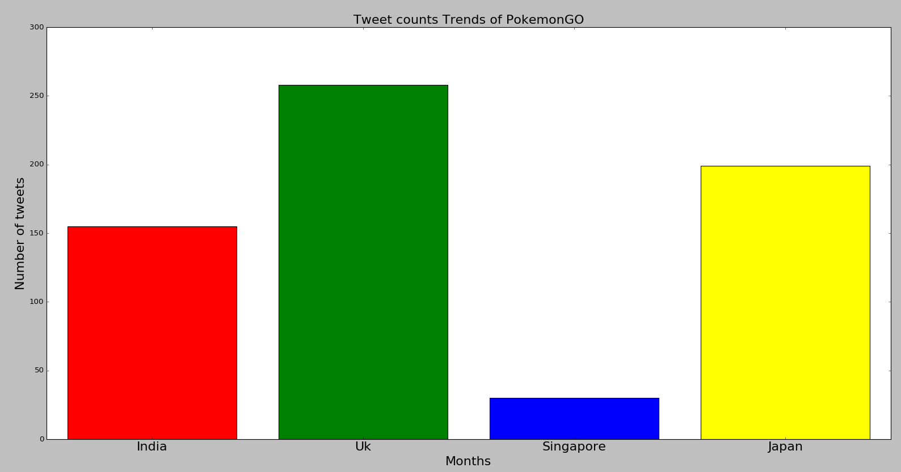
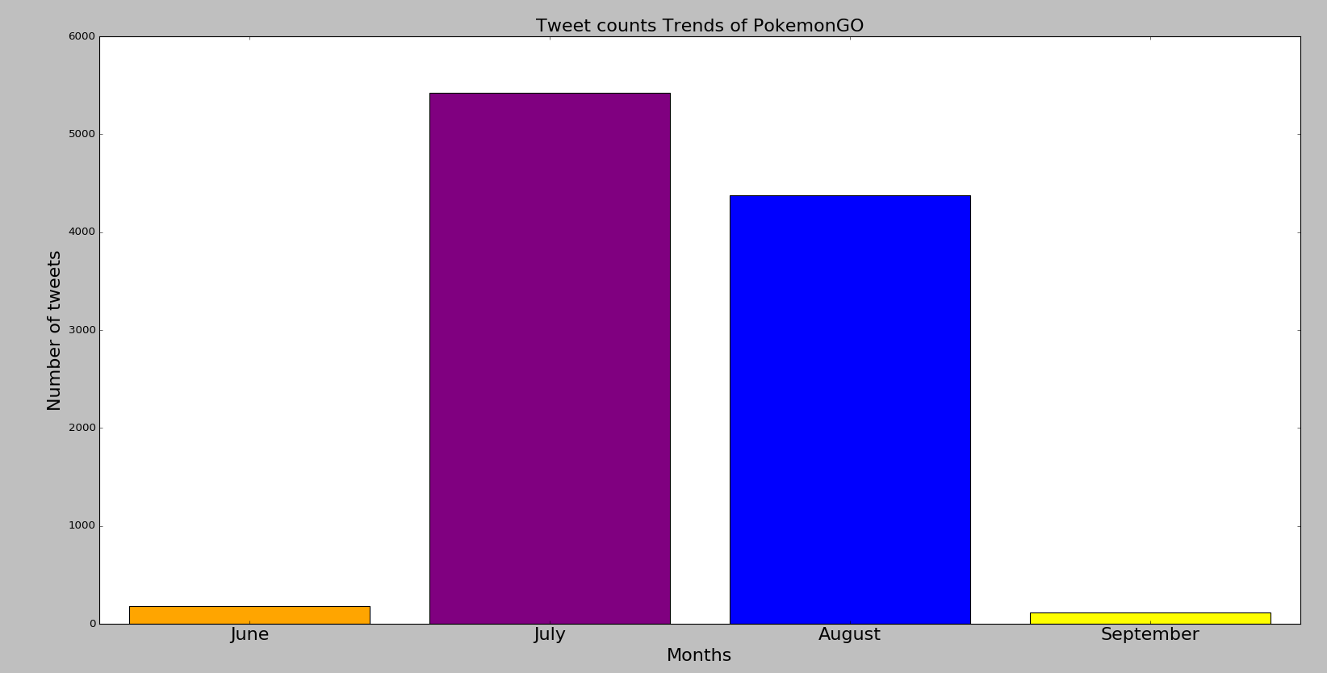
Target Market Trends
#PokemonGo Tweets
#PokemonGo tweets based on location

Slide 13
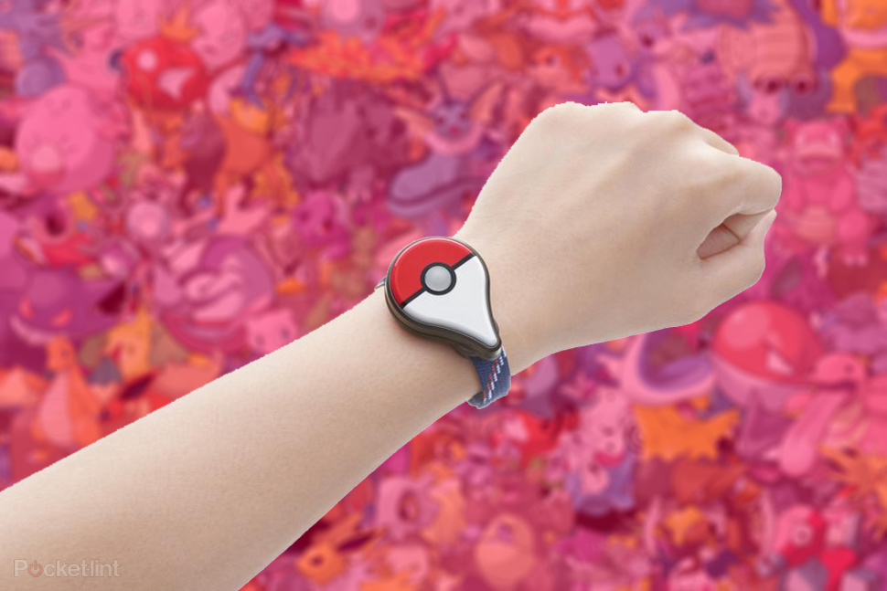

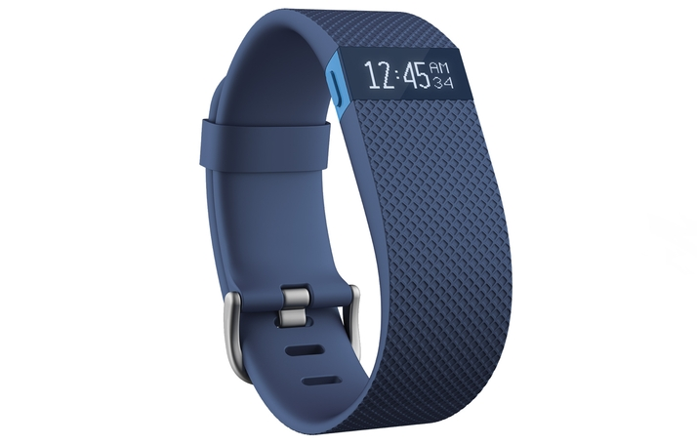
Influence on Retail
Compared FitBit and Pokemon Go Plus band
#PokemonGOPlus tweets: 3,469
Retail Merchandise

Slide 14
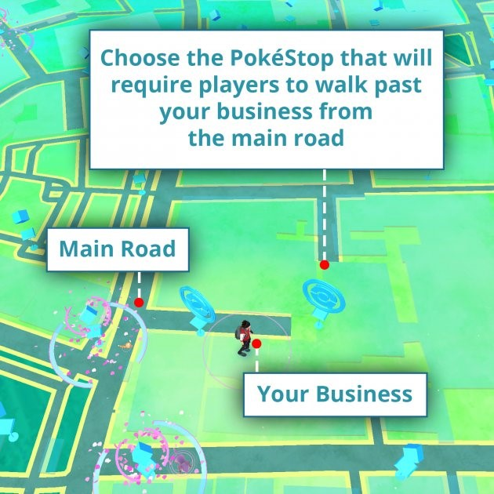
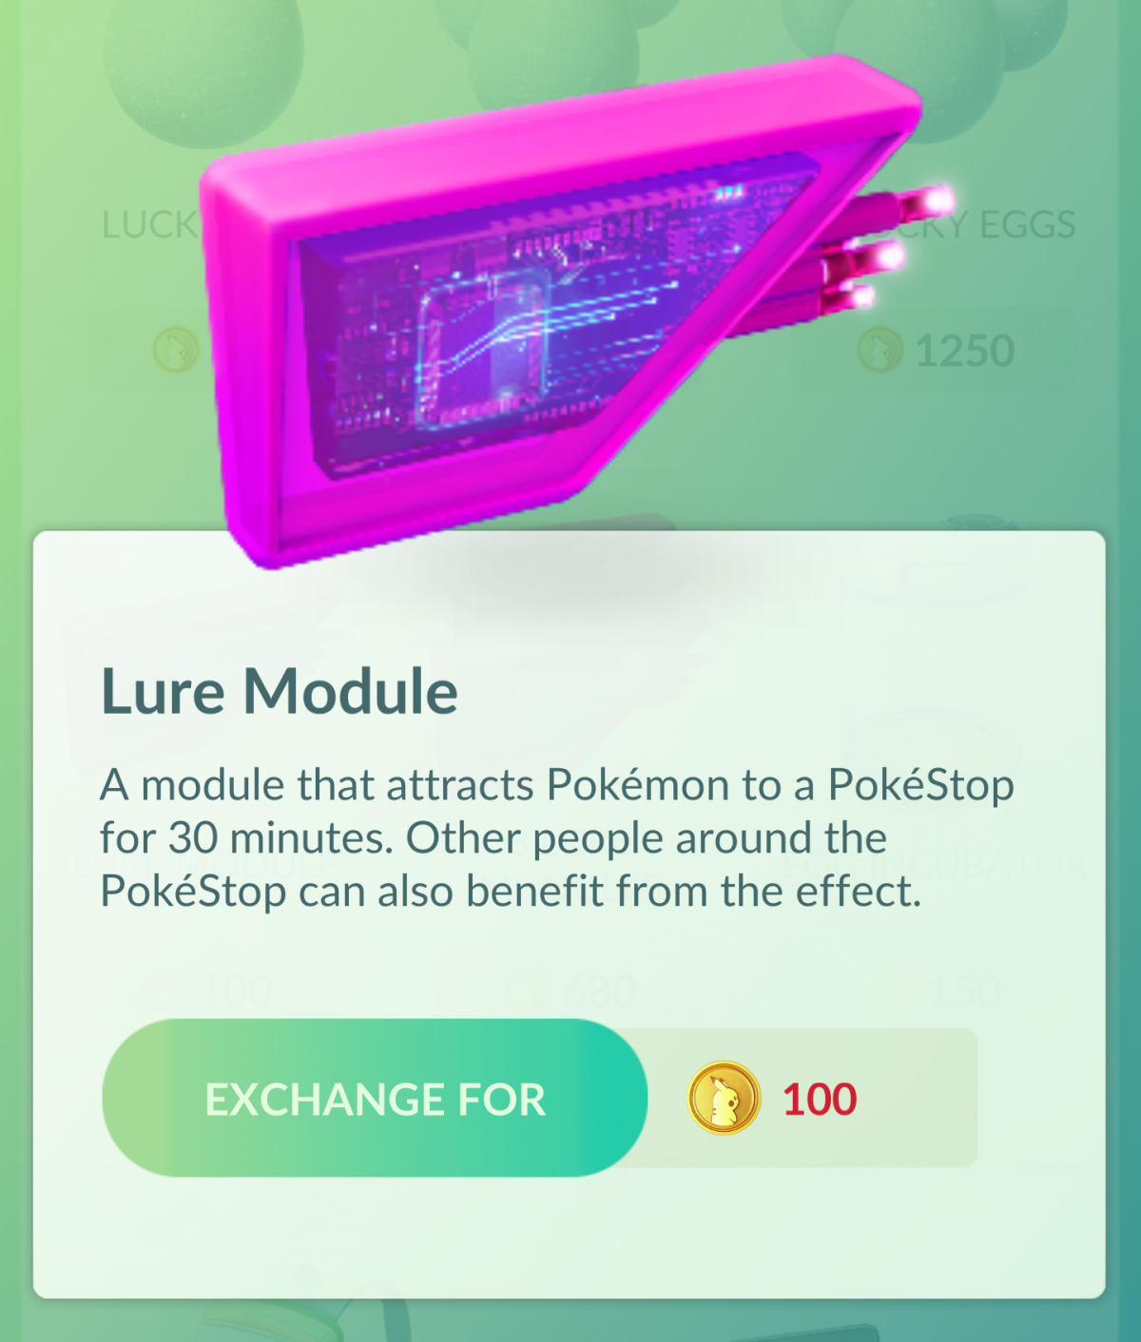
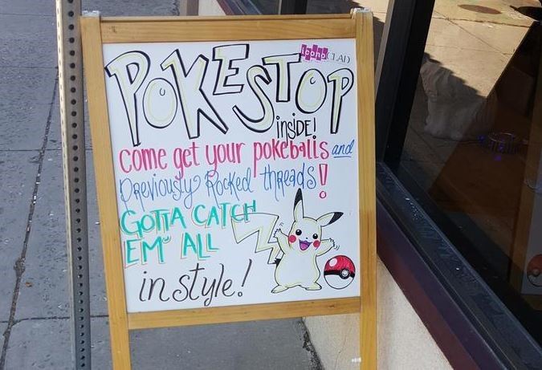
Influence on Retaurants
Pokémon GO has a purchasable in-game item called a “Lure Module”
Attracts Pokémon to a particular Poke Stop for 30 minutes
Social Media Marketing
Marketing With Sponsored Locations
Increase footfall

Slide 15

Thank You

Slide 16

Questions

